Slide 1



An app by Stephany, Filip, Jeff and Aar

Slide 2


Our Elevator Pitch

Slide 3

Concept
Learn a new language while making new friends globally!
Wouldn’t it be great if you could make friends internationally without language as a barrier?
Our co-founders wanted a way to discuss anime with fellow fans of the artform, make friends, as well as an opportunity to intuitively learn new languages in the process.
Teach Thru Talk is where these three opportunities converge!

Slide 4
Process
Our application was created using a combinationon of HTML, CSS, JavaScript, Node, Express, MySQL, Sequilize, and the DeepL translate API.
Our app was deployed to Heroku, utilizes JawsDB and has a mirror Github repository.
Our team worked on all different aspects of code, with their respective snippets of code being share via commits to a shared Github repository.
The primary challenges encountered creating our application were creating and interacting with the database, the map, the restful API, authentication for login, finding bugs and tying the front end to the back-end via routing.

Slide 5

Progress
We were able to successfully create a working MVP that we can build on!

Slide 6
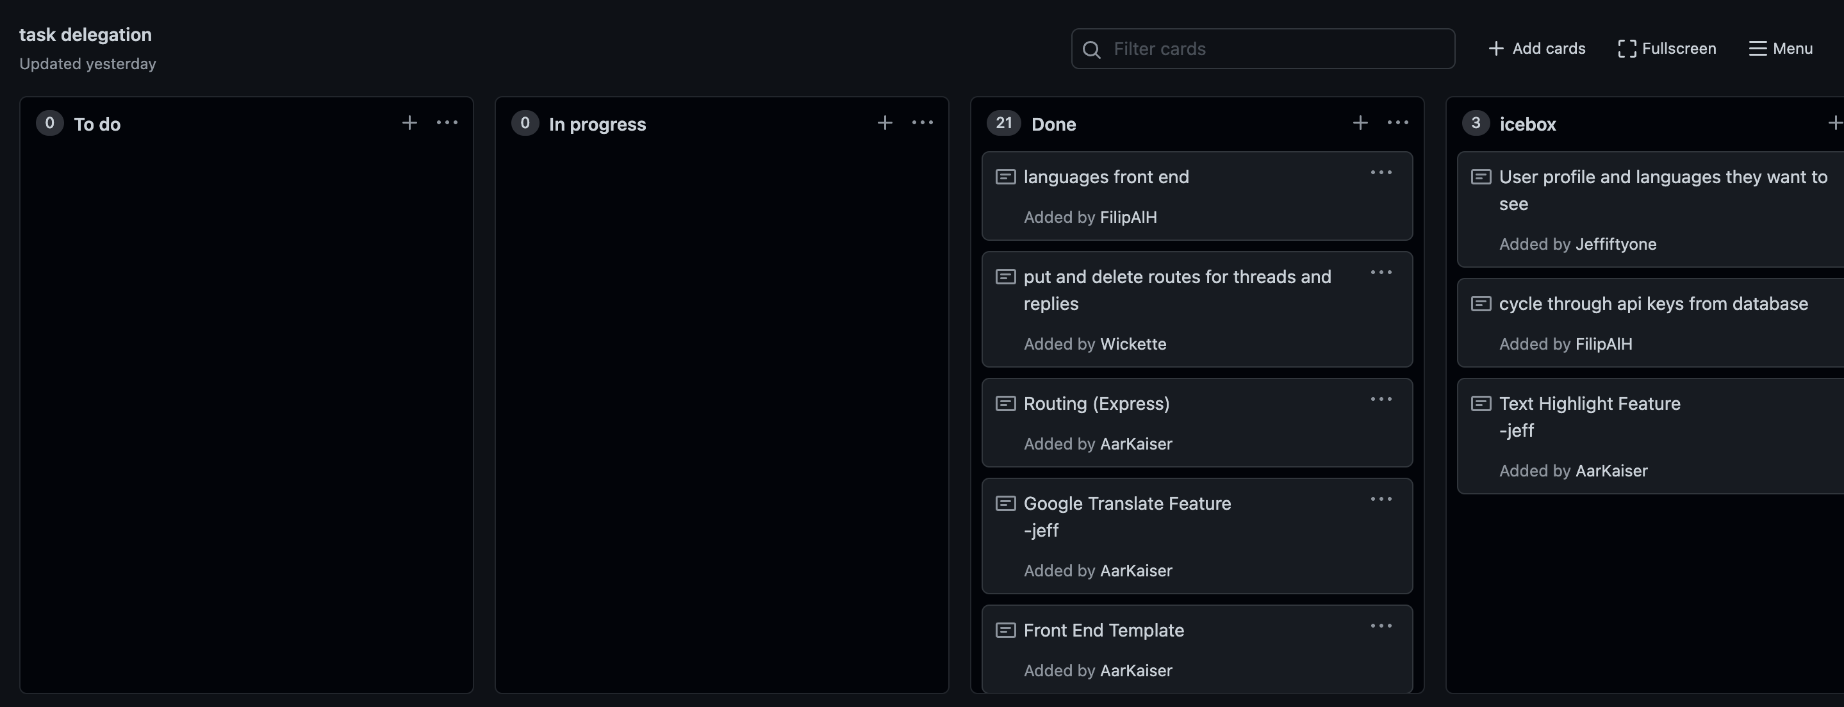
Individual Roles

Slide 7
Our MVP Demo

Slide 8
Directions for Future Development
We plan to incorporate more languages by using a translator that’s less Euro-centric, and offers support for a broader selection of languages.
We plan to be able to set a default language for each individual user on signup, store that information, and translate render the website in their preferred language every time they log in (using cookies).
We plan to make the landing page more enticing to “lurkers,” to convince them to sign up for traction and retention in order to grow our community.
We also plan to add a night-mode feature for our night-owl users.

Slide 9
Links & Credits:
Teach Thru Talk (Deployed on Heroku)
GitHub repo
Background Music: Walking On A Dream
Credit: Empire of the Sun

Slide 10
The End
Thank You!

